Slide 1
EPRI Update on Latest Research and Testing of Control Systems
Dr. Arindam Maitra, Technical Executive, EPRI
Microgrid & DER Controller Symposium MIT Samberg Conference Center, Cambridge, MA
Feb 16th, 2017
Notes:
Good afternoon and thanks all for joining today’s EPRI P174 webcast.
I’m Nadav Enbar and I’m joined by my colleague Steven Coley. Together we’ll be presenting an update on research activities and developments coming out of Project Set D, which focuses on the utility business impacts of DER, primarily PV, as well as associated best practices.
As we’ll get into further in just a minute, today’s webcast is intended to reiterate PSET objectives, remind you about scheduled base deliverables and our approach to fulfilling them, and where applicable, share insights derived from research that we’ve either completed to date or that are nearly completed.

Slide 2
A Practical Microgrid Goal by 2020…
Maximize project lifecycle value for economic and technically feasible opportunities in our evolving grid environment
Operations & Control
Performance Metrics
Control Objectives
Communications infrastructure
Protection and DER Coordination
Creating a microgrid is complicated ….
Involves multiple power, operations management and control system components from diverse vendors that must be integrated and optimized for interoperability and security
Integrated controls, communication & coordination, and new protection approaches are needed
Assets within the microgrid must comply with the distribution system operator’s interconnection requirements

Slide 3
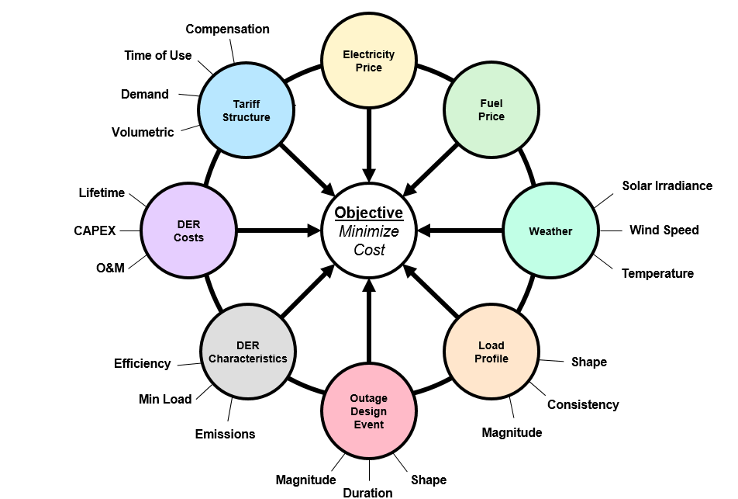
Key Parameters Impacting Microgrid Operations and Cost
A variety of factors, many interconnected, impact the overall design and cost of a microgrid. Certain factors are considered fixed inputs (i.e. assumptions) while other factors are varied to in order to evaluate the sensitivity of their impact on overall cost.

Slide 4
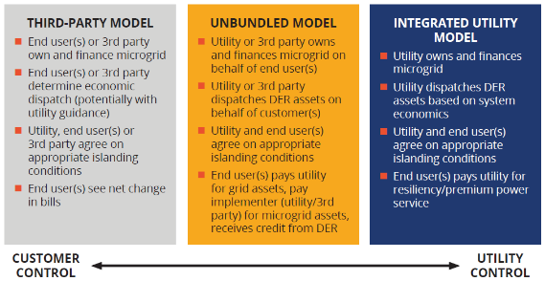
Microgrid Business Models Can Impact Controller Operation
For more information – “Microgrids: Expanding Applications, Implementations, and Business Structures”. EPRI/SEPA whitepaper.

Slide 5
Transitions and Impact of Controls
Source IEEE 2030.8

Slide 6
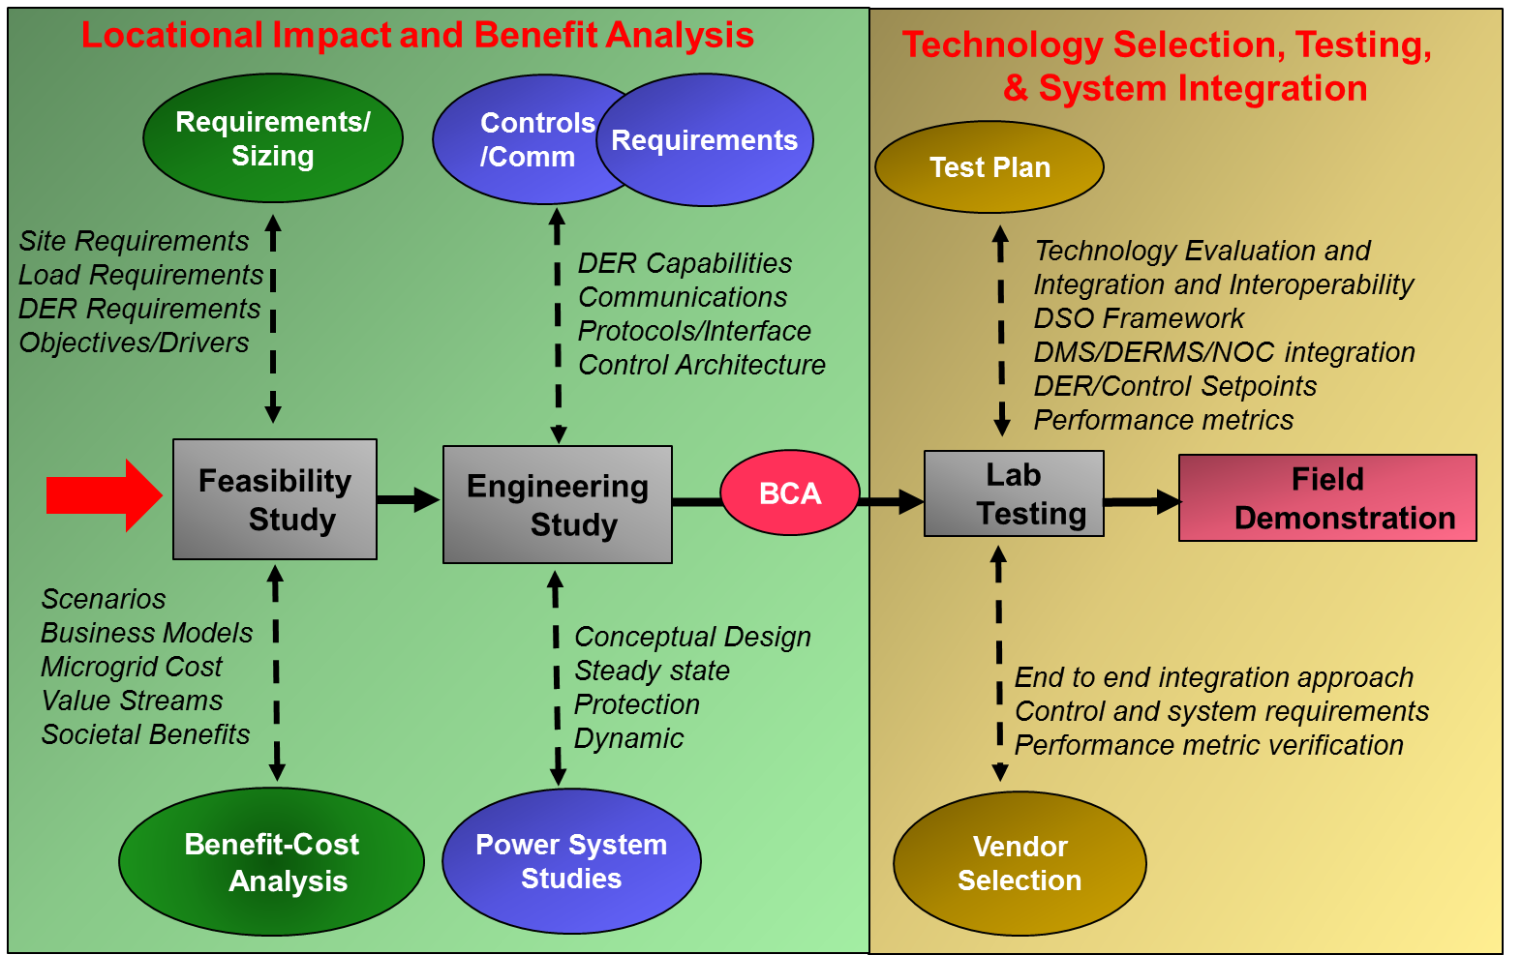
Develop Consistent Approaches to Evaluate Microgrid Adoption: Evaluation, Design, Testing & Demo

Slide 7
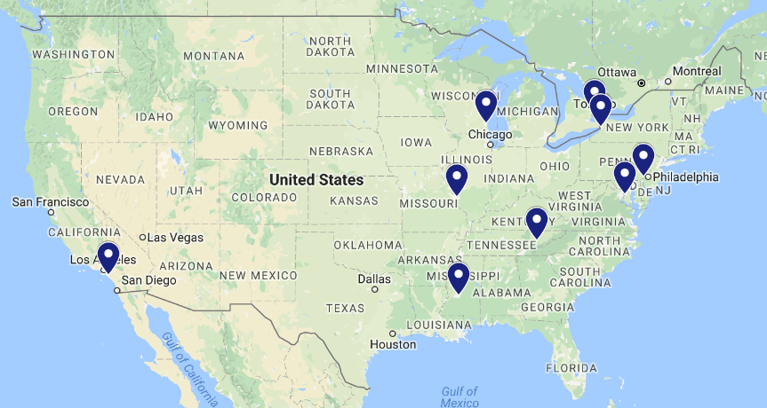










EPRI Microgrid Feasibility and Design Projects
OPG
Century City
BNMC
Concordville
Washington University
St. Elizabeth
Cherokee Farms
UC Irvine
UMMC

Slide 8
List of Current Microgrid Controller Projects
DOE Microgrid Projects
FOA 997 Controller (End Date May 2017) Spirae Controller
DMS Structuring Project Phase 1/2 (October 2015 – November 2017) Schneider & GE Controller
ADMS Test bed (November 2016 – November 2019) Schneider & GE Controller
ARPA E with UTK TI Controller
DoD Microgrid Projects
Transportable Microgrid (Dec 2016-Dec 2018). SEL Controller
Fort Hunter Liggett (Sep 2016 – Dec 2017). LBNL Controller
NYSERDA Microgrid Projects
Phase 2 BNMC NYSERDA Spirae/OpusOne Controller
Utility Funded Demonstrations
NCEMC, Xcel, HydroOne, Central Hudson

Slide 9
Microgrid Controller Test Options – Which is Better?
Pure simulation
Abstract or real-time
Need to integrate MGC
EPS
CHIL
Interface real controller
Real-time simulation
EPS
DER
G
DER
G
MGC
MGC
CHIL & PHIL
Interface real controller and assets
Power interface, more complex
Power
Real controller and assets
Simple EPS model
EPS
DER
G
DER
G
MGC
MGC
CHIL = Controller Hardware-in-the-Loop; PHIL = Power Hardware-in-the-Loop
MGC = Microgrid controller; DER = Distributed Energy Resource; G = Generator; EPS = Electric Power System

Slide 10

Need IEEE 2030.8 to Define Microgrid Controller Testing Procedures and Evaluations
Test case: | Met Requirement?
A.1.1: DER available (renewables only); Wave offline.
A.2.1: System importing power at PCC
A.2.2: System importing power at PCC (loss of one generator)
A.3.1: System exporting power at PCC
A.3.2: System exporting power at PCC (loss of one generator)
A.4.1: System net-zero power at PCC
A.4.2: System net-zero power at PCC (loss of one generator)
A.4.3: System net-zero power at PCC (loss of communications MG/Wave)
B.1.1a: Planned disconnection using microgrid controller interface
B.1.1b: Planned disconnection (high renewable penetration)
B.1.2: Planned disconnection (loss of one generator)
B.2.1: Unplanned disconnection via manual breaker trip
B.2.2: Unplanned disconnection via manual breaker trip (loss one generator)
B.2.3: Unplanned disconnection via protective relay trip

Slide 11
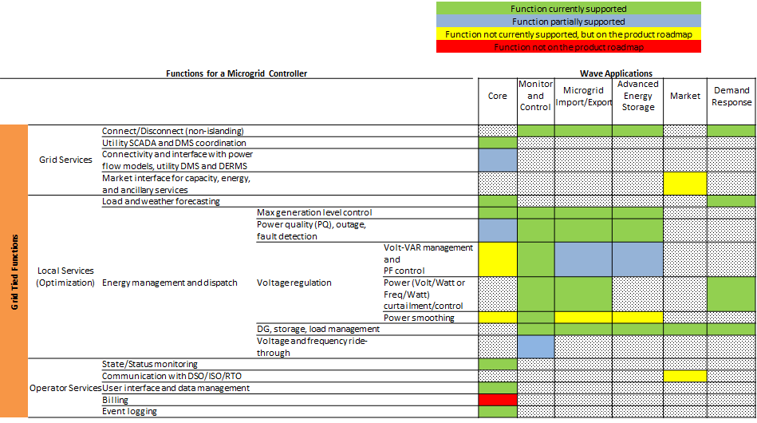
Need for an Uniform Way to Evaluate Multiple Vendor Control Systems
Single product compliance
Does it meet IEEE 2030.7 core level functions?
Does it meet additional customer requirements?
Product comparison
How do these controllers compare?
Requires testing in the context of a microgrid system
Site-specific compliance
Is it capable of managing this microgrid’s assets in order to meet these interconnection requirements?

Slide 12
CHIL & PHIL for Site-Specific Evaluation
Model of site EPS
Actual or representative DER
reduce modeling inaccuracies
proprietary controls
EPS
DER
G
MGC

Slide 13
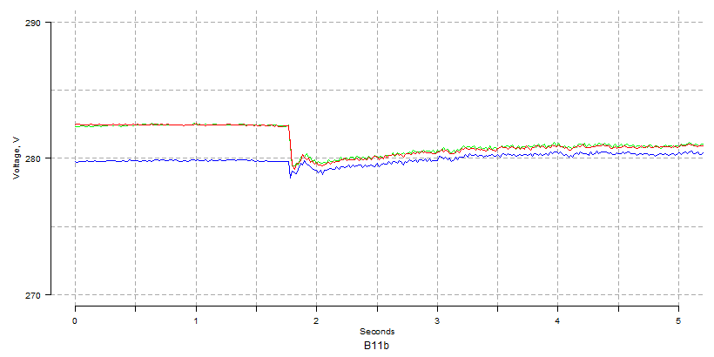
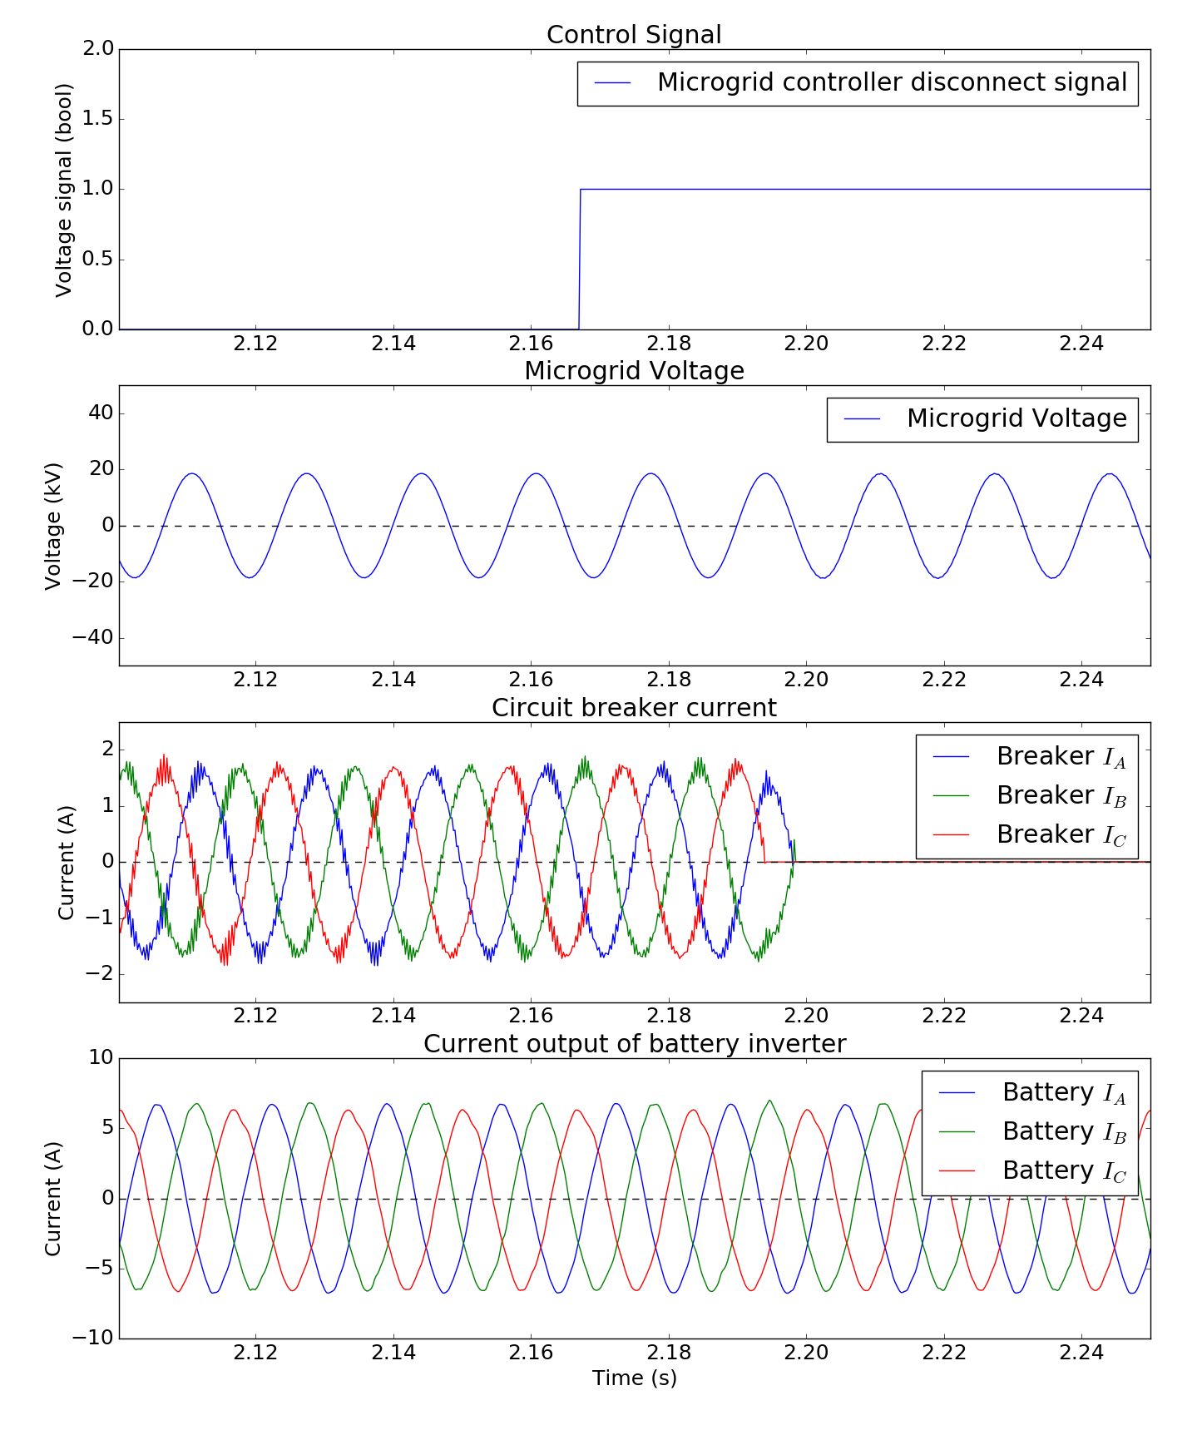
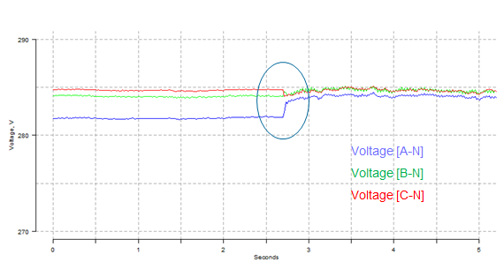
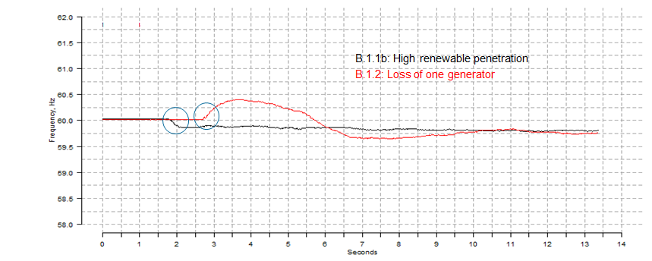
Verify Controller Functions and Capabilities
Voltage [A-N]
Voltage [B-N]
Voltage [C-N]

Slide 14
CHIL/PHIL Test @NREL
PHIL & CHIL evaluation of microgrid controller for Buffalo Niagra Medical Campus (BNMC) site
DOE FOA 997 functional requirements
CHIL: Spirae Wave controller
PHIL: ESS inverter (representative)
Notes:
Resources
1.2 MWac rooftop PV,
26 MW_{ac} NRG PV,
5 MW Desert Green CPV, {concentrator photovoltaic (CPV) modules}
2, 1.8 MW Diesel Generators,
1.5 MW, 4.5 MWh substation energy storage {consists of a 500 kW, 1.5 MWh (SES1) and a 1 MW, 3 MWh (SES2) Lithium Nickel Cobalt Aluminum battery system, the latter with black start capability}, and
75 kW, 150 kWh community Lithium Ion batteries {consists of three 25 kW, 50 kWh Lithium Ion phosphate battery systems}
http://energy.gov/sites/prod/files/30_SDGE_Borrego_Springs_Microgrid.pdf

Slide 15
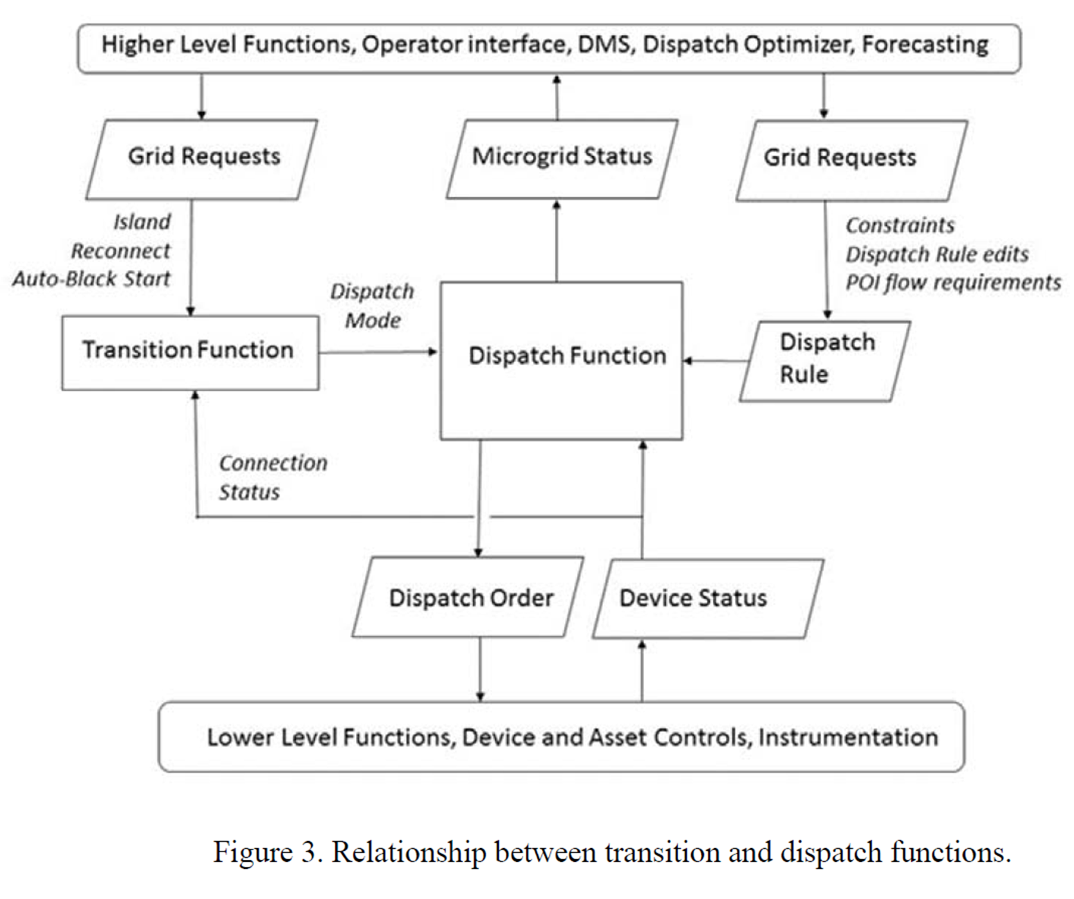
DMS-DERMS-Microgrid Controller-DER
DMS
Group-Level Functions
Microgrid Controller
Device-Level Functions
Devices

Slide 16
Establish End-to-End Connectivity
DMS
DMS Applications
VVO
FLISR
DER Group Functions
OLPF
Status Monitoring
…
Output Forecasting
Max Real Power Limiting
Real Power Dispatch
Reactive Power Dispatch
Connect/Disconnect
Microgrid Controller
Microgrid Internal Functions
Dispatch
Transition
DER Device Functions
…
Status Monitoring
Output Forecasting
Fixed PF
Volt-VAR
Volt-Watt
Devices
…
Device Internal Functions

Slide 17
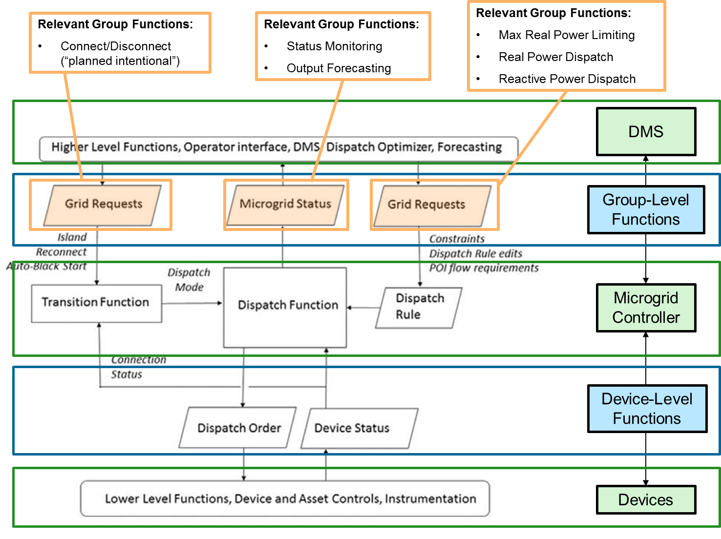
DER Group Functions and Messages

Slide 18
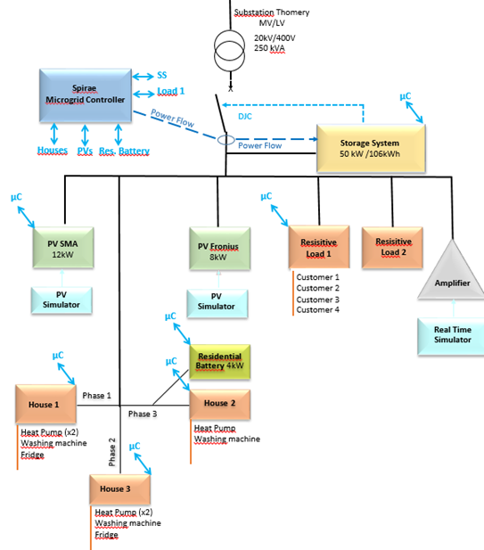
Microgrid Controller Testing @ EDF Concept Grid
Benefits of Testing at EDF’s Concept Grid:
Verify capabilities of Wave controller in an environment not limited by the scale or capacity of the power system it is controlling
Verify communication latency issues
Equipement type | symbol | Equipment details
Air conditioner | A/C 1 | Mitsubishi 1 kVA
 | A/C 2 | Mitsubishi 1.4 kVA
 | A/C 3 | Daikin 3.5 kVA
 | A/C 4 | Daikin 3.5 kVA
inverter | =\~ 1 | SMA STP 15000TL-10
 | =\~ 2 | Fronius IGplus 150V-3
 | =\~ 3 | SMA Sunny island SI6.0H-11
Washing Machine | WM 1 | Electrolux 2.2 kVA
 | WM 2 | Electrolux 2.2 kVA
 | WM 3 | Boch 2.4 kVA
April 6-7, 2017

